Slide 1
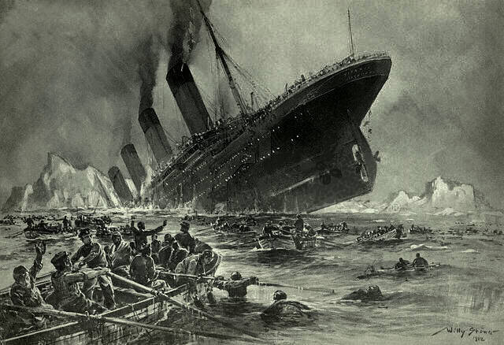

Predict Survived on Titanic
USING PYSPARK AND PYTHON IN DATABRICK

Slide 2
Coaching: Ho Nhut Minh
DT2210L
Le Canh Sang

Slide 3
Contents
01
02
03
History
Why?
About Data
04
05
06
Data Visualization
Machine Learning
EDA

Slide 4
History
1909 - April 1st, 1912
April 10th, 1912
Four days after leaving Southampton
Having been laid down in 1909 it would take three years of construction and fitting out before RMS Titanic was ready for sea, commanded by veteran Captain Edward John Smith.
RMS Titanic was a British registered four-funnelled ocean liner built in 1912 for the transatlantic passenger and mail service between Southampton and New York.
On 10 April 1912 the Titanic sailed from Southampton, England with 2,200 passengers and crew she was bound for New York. Titanic's Schedule took in stops at Cherbourg, France and Queenstown, Ireland
Aboard were 2208 people - all ages, creeds and colour; the wealthy, middle class and the poor. If you could walk her decks of you would hear a dozen or more languages being spoken with every imaginable dialect.
The Titanic collided with an iceberg and sank: 1500 people died and 700 survived. The Titanic is famous for many reasons.

Slide 5
Why did I choose this title?
Analyzing predictions about the number of survivors on the Titanic is an important topic in scientific research and history. The main reason is to gain a better understanding of the factors that influenced the survival chances of each individual in this tragedy. By analyzing data and factors such as gender, age, ticket class, and embarkation location, we can approach grasping patterns of behavior and laws occurring in emergency situations like this.
Aside from providing a deeper insight into this historical event, analysis can also help us draw important lessons. By understanding how factors like education level and social status may impact survival chances, we can identify means to improve emergency response plans and safety policies aboard ships and in similar emergency situations.
Finally, analyzing predictions about the number of survivors on the Titanic can also offer us profound insights into computation and forecasting in the field of data science. By employing analysis methods and data modeling, we can understand better how algorithms can be applied to predict outcomes in the future based on existing data.

Slide 6

Why did I choose Apache Spark instead of Hadoop ?

Slide 7
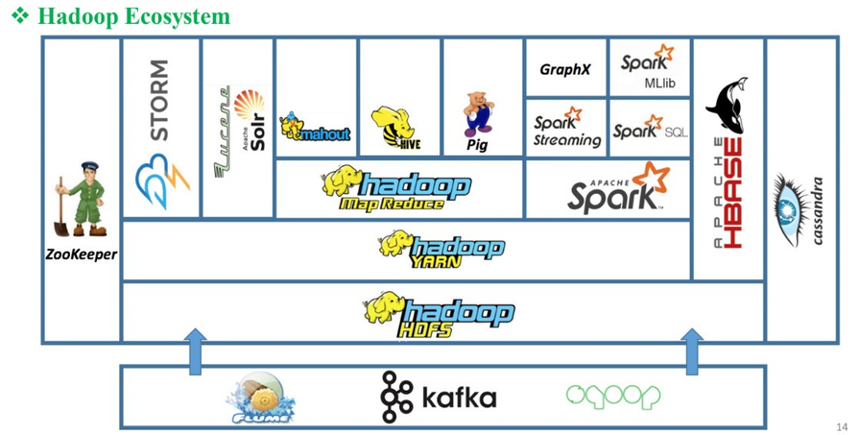
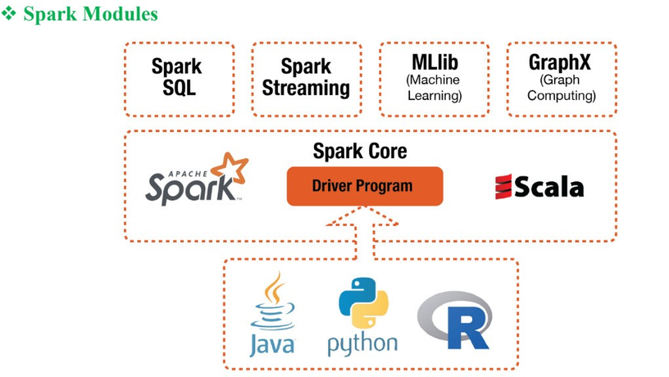

Slide 8

Python is one of the most commonly used programming languages most widely used by data scientists, analysis, data analysts, and many other IT experts. They choose Python due to its simple, interactive interface and language Easy to learn, multi-purpose language. What's more, Python is data scientists trust when performing analytics Data Analysis, Machine Learning
Learning) and jobs on big data.
The combination of Spark and Python is a great combination elephant in the world of Big Data - PySpark
The Apache Spark community has released a tool called
PySpark (Python API for Apache Spark.)

Slide 9

Databricks is a cloud-based data analysis platform built on Apache Spark, focusing on providing a unified and integrated workspace for data analysts. With features like integration with Apache Spark, collaborative working environment, and automatic scalability, Databricks helps optimize performance and reduce deployment time for data analysis projects

Slide 10
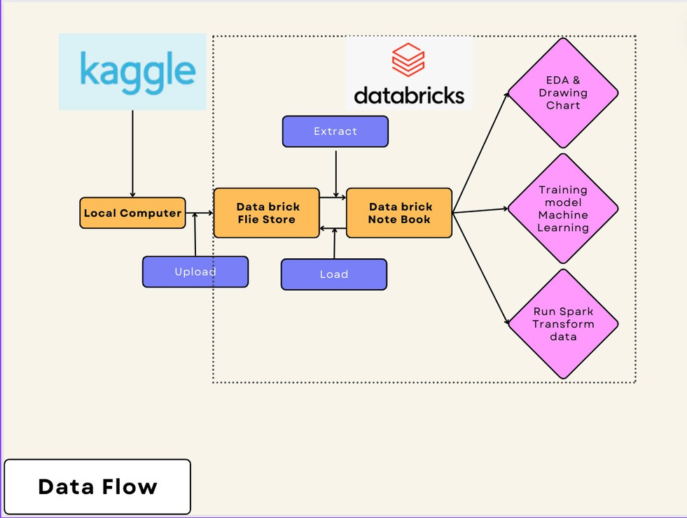
Data Flow

Slide 11
About Data
Data Soucre from Kaggle: https://www.kaggle.com/competitions/titanic
This Project has 2 files csv: train.csv, test.csv
file : train.csv (891 elements), test.csv(413 elements)
PassengerId: Passenger ID.
Survived: Target variable, representing whether the passenger survived (1) or not (0).
Pclass: Passenger class.
Name: Passenger's name.
Sex: Passenger's gender.
Age: Passenger's age.
SibSp: Number of siblings or spouses accompanying.
Parch: Number of parents or children accompanying.
Ticket: Ticket number.
Fare: Ticket price.
Cabin: Passenger cabin.
Embarked: Port of embarkation.
But file test.csv not has Survived column. So I must make prediction model for predict who survived

Slide 12
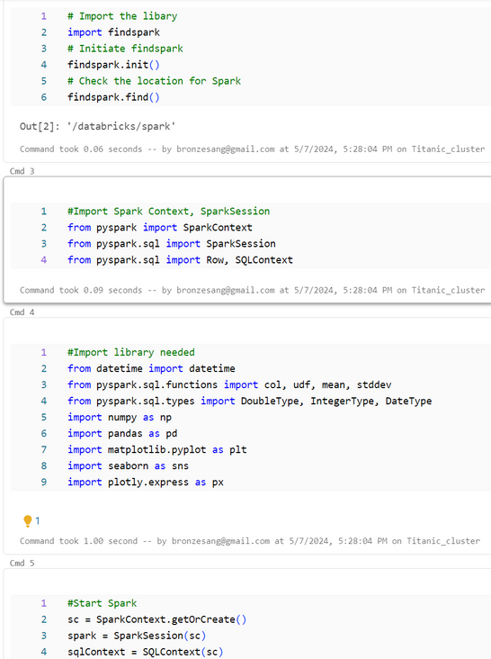
EDA
1.1 Initialize spark on DataBricks
Import library needed
Start Spark

Slide 13
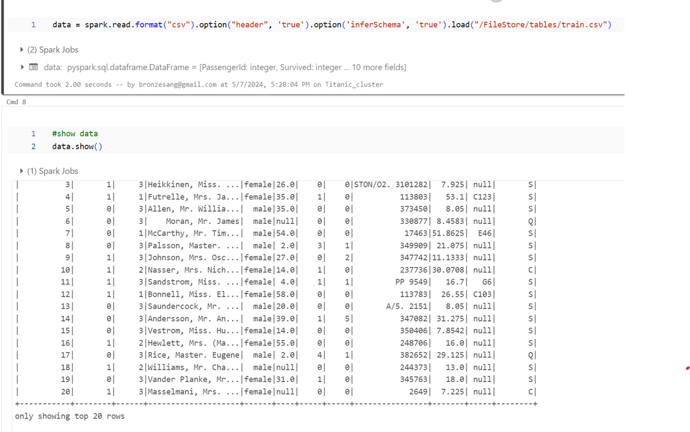
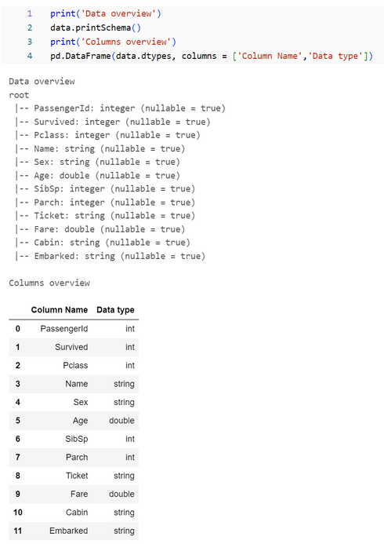
EDA
1.2 EDA

Slide 14
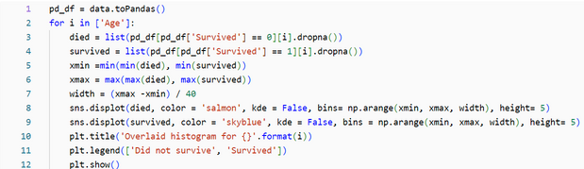
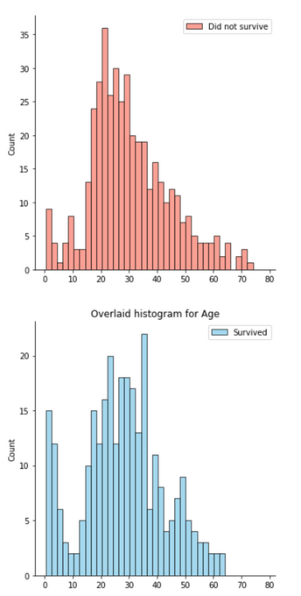
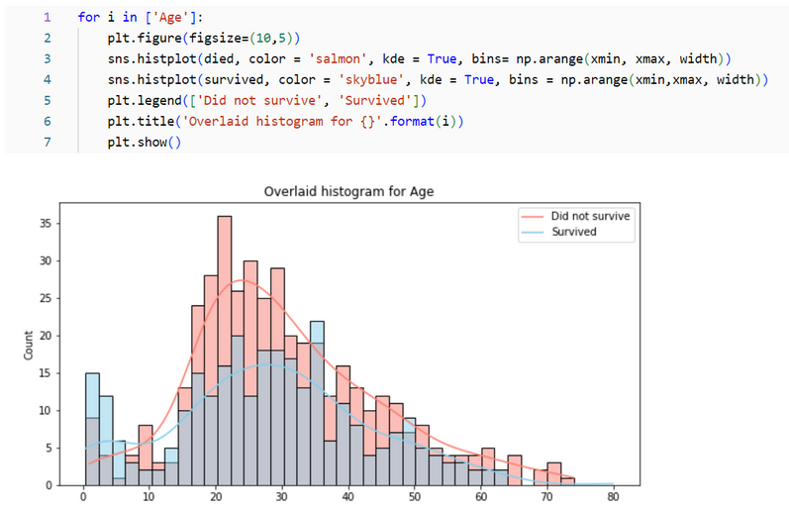
EDA
1.2 EDA
Compare survivor ages before EDA

Slide 15
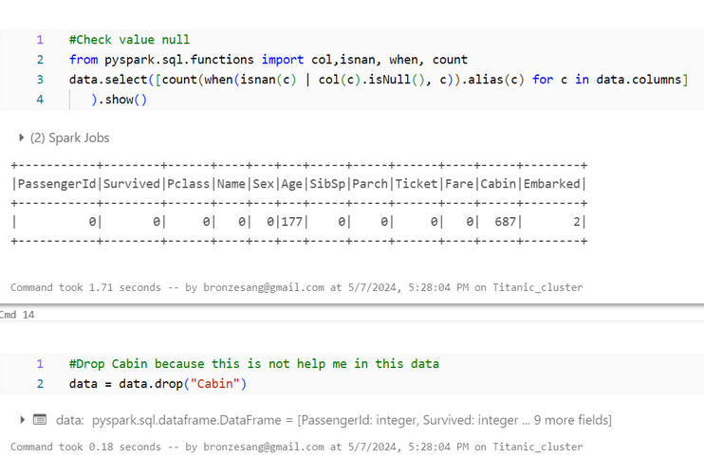
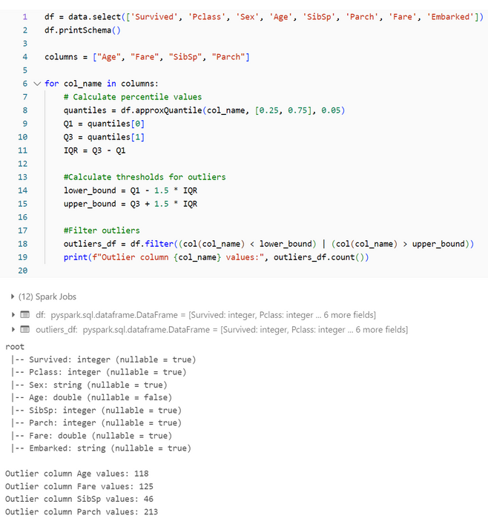
EDA
1.2 EDA
They have 3 columns contains null values
They have 4 columns contains outlier values

Slide 16
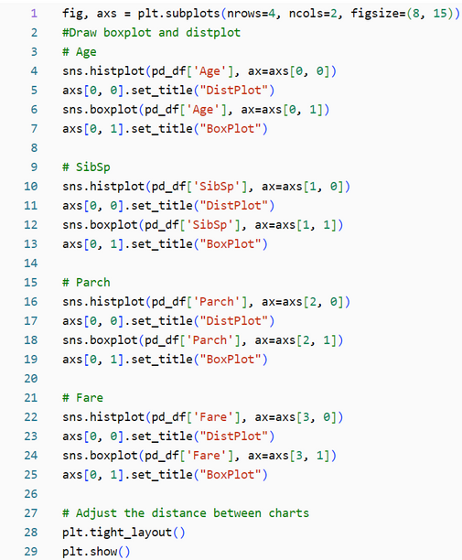
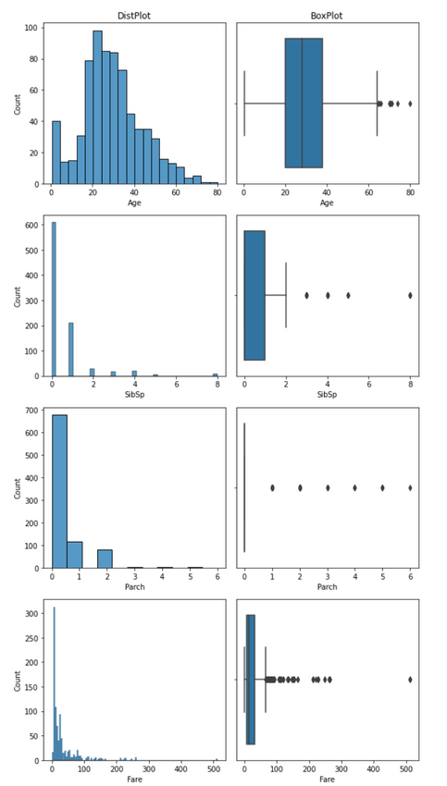
EDA
1.3 Check information before filtering data

Slide 17
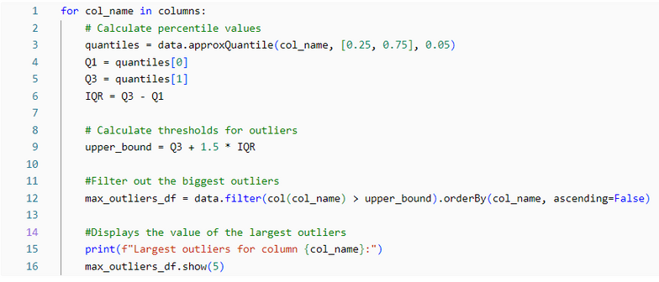
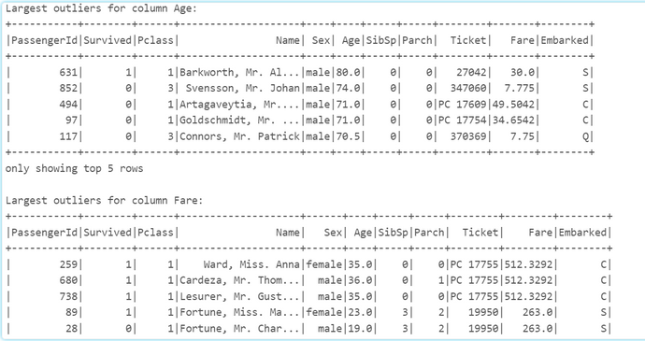
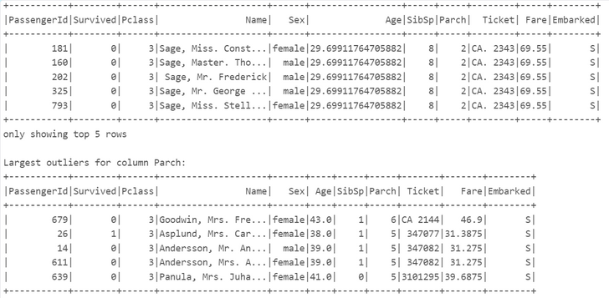
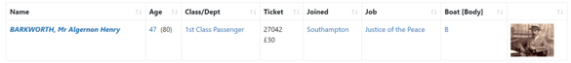
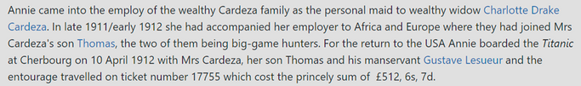
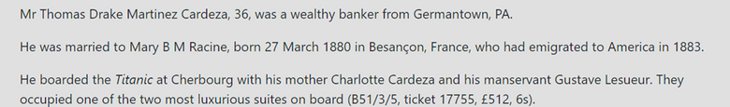
outlier values in data is real , so keep data for analyst

Slide 18
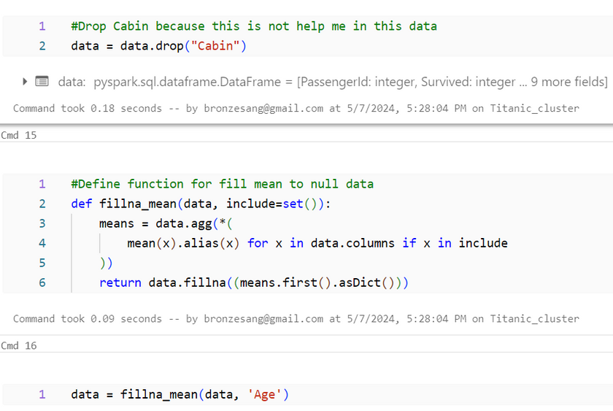
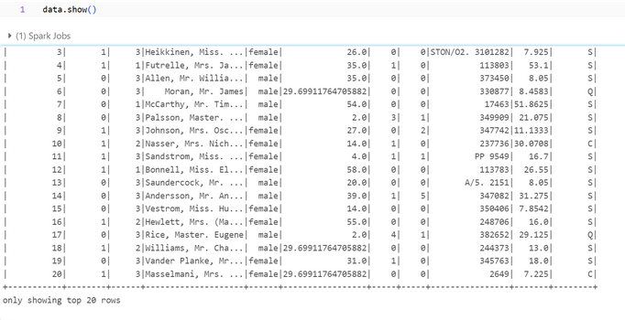
EDA
1.4 Drop

Slide 19
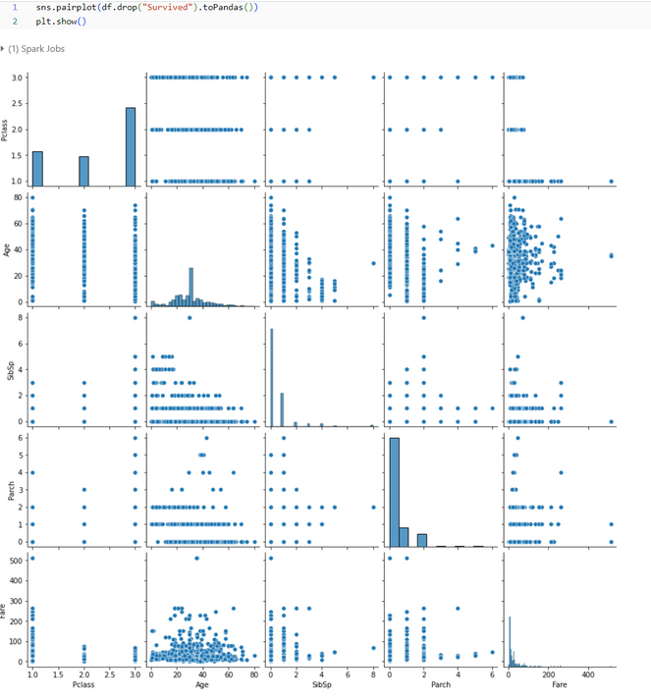
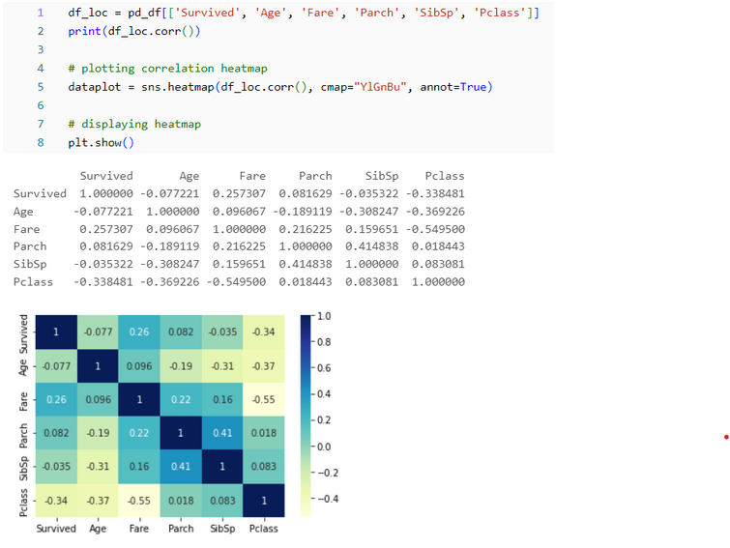
EDA
1.5 Correlation

Slide 20
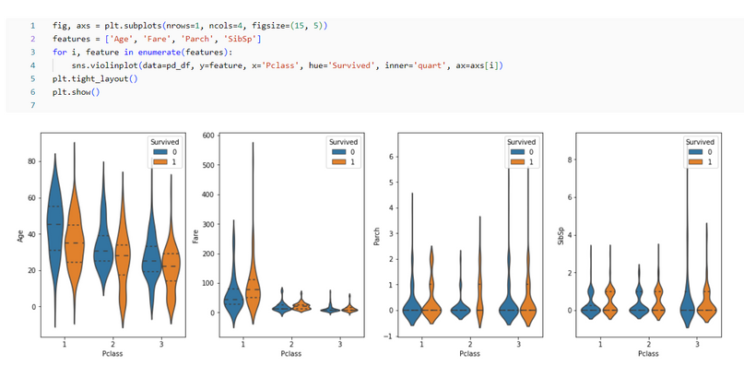
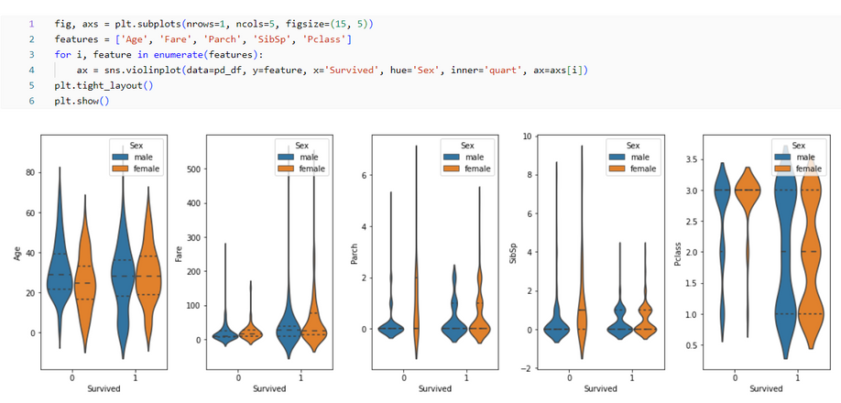
Data Visualization
2.1 Compare elements to ML

Slide 21
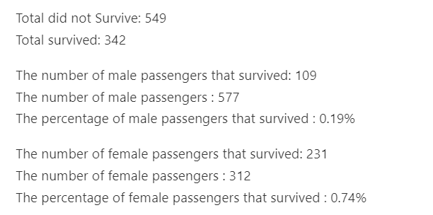
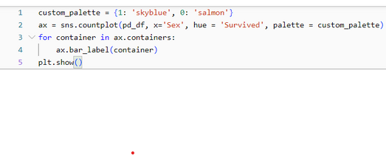
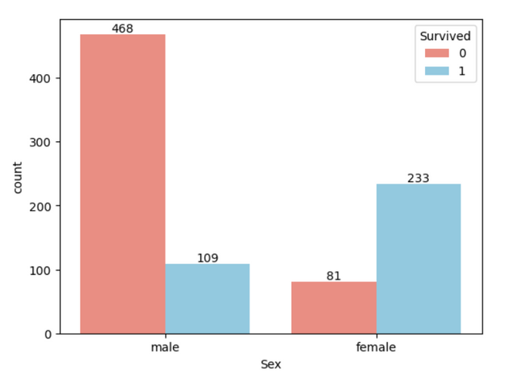
Data Visualization
2.1 Compare elements to ML

Slide 22
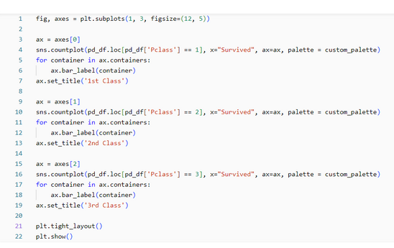
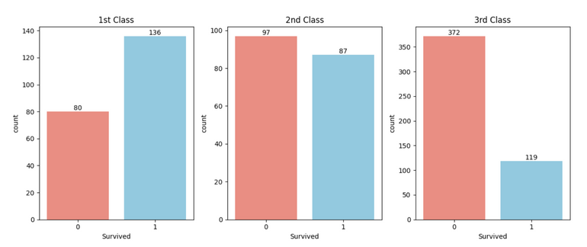
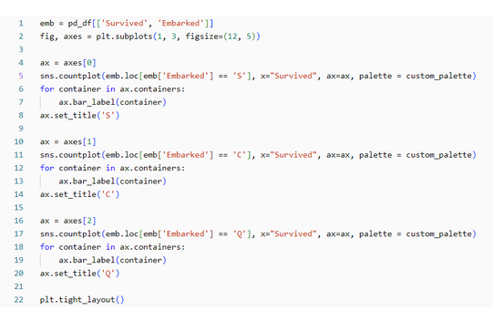
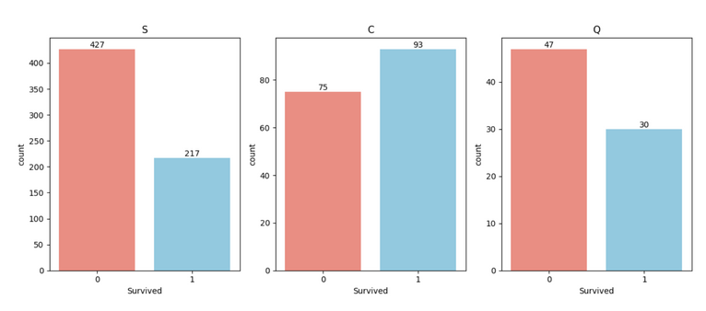

Slide 23
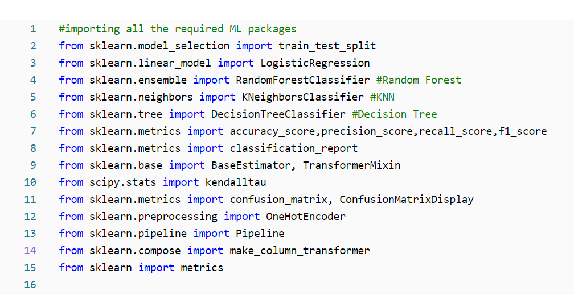
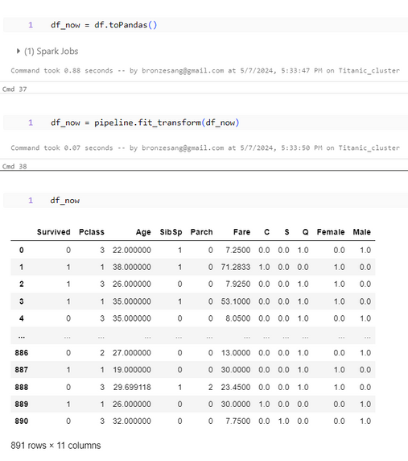
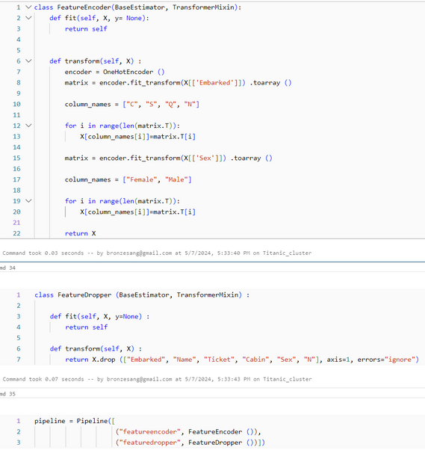
Machine Learning
3.1 Build and Test Model
Create 2 class to separate values into binary coefficients

Slide 24
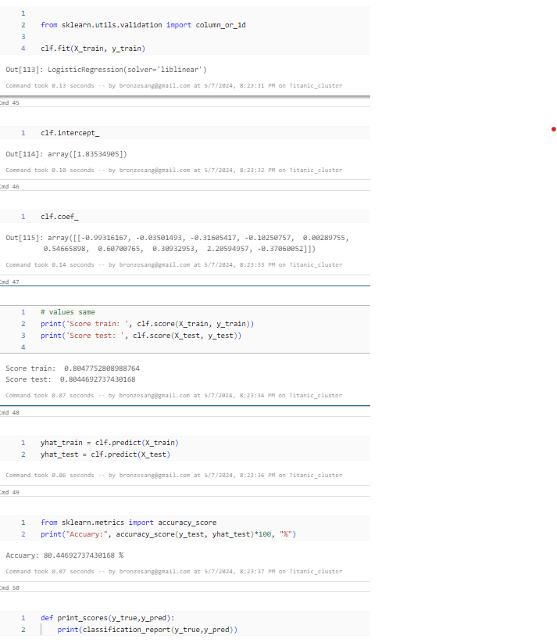
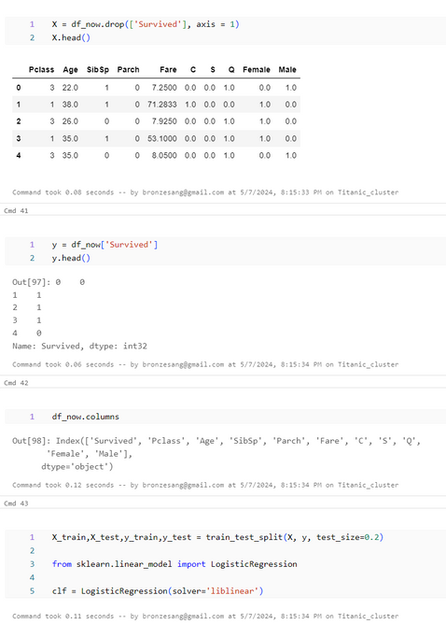
Machine Learning
3.1 Build and Test Model
The model has almost the same training and testing scores and about 80% has no overfitting or underfitting

Slide 25
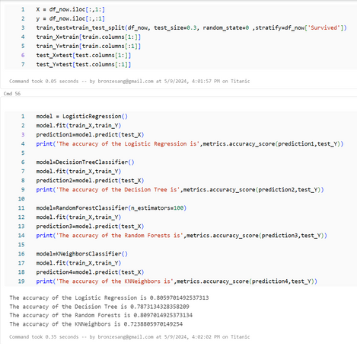
Machine Learning
3.2 Confusion Matrix Display and compare some other models
I have gained some insights from the EDA part. But with that, I cannot accurately predict or tell whether a passenger will survive or die. So now I will predict whether the Passenger will survive or not using some great Classification Algorithms. Following are the algorithms I will use to make the model:
1)Logistic Regression
2)Random Forest
3)K-Nearest Neighbours
4)Decision Tree
The accuracy of a model is not the only factor that determines the robustness of the classifier. Let's say that a classifier is trained over a training data and tested over the test data and it scores an accuracy of 90%.
Now this seems to be very good accuracy for a classifier, but can I confirm that it will be 90% for all the new test sets that come over??. The answer is No, because I can't determine which all instances will the classifier will use to train itself. As the training and testing data changes, the accuracy will also change. It may increase or decrease. This is known as model variance.
To overcome this and get a generalized model, I use Cross Validation

Slide 26
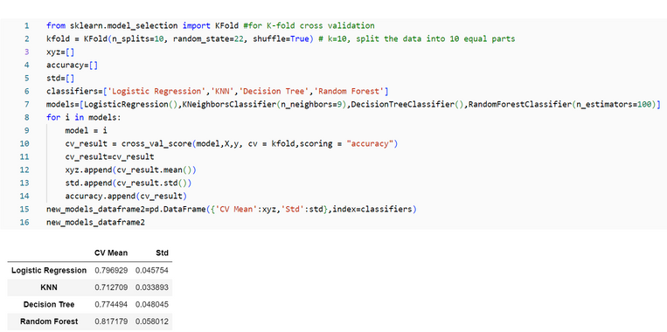
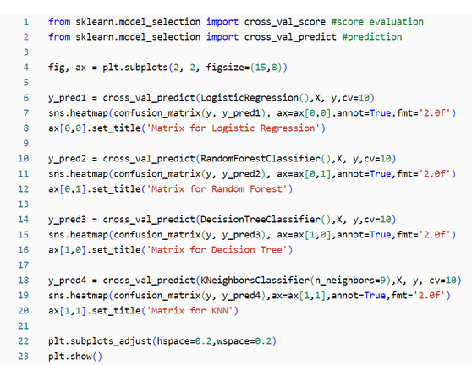
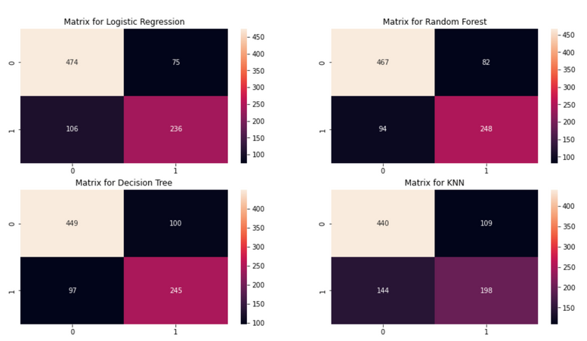
Machine Learning
Cross Validation
Many a times, the data is imbalanced, i.e there may be a high number of class1 instances but less number of other class instances. Thus I should train and test our algorithm on each and every instance of the dataset. Then I can take an average of all the noted accuracies over the dataset.
1)The K-Fold Cross Validation works by first dividing the dataset into k-subsets.
2)Let's say I divide the dataset into (k=5) parts. I reserve 1 part for testing and training the algorithm over the 4 parts.
3)I continue the process by changing the testing part in each iteration and training the algorithm over the other parts. The accuracies and errors are then averaged to get an average accuracy of the algorithm.
This is called K-Fold Cross Validation.
4)An algorithm may underfit over a dataset for some training data and sometimes also overfit the data for other training set. Thus with cross-validation, I can achieve a generalised model.

Slide 27
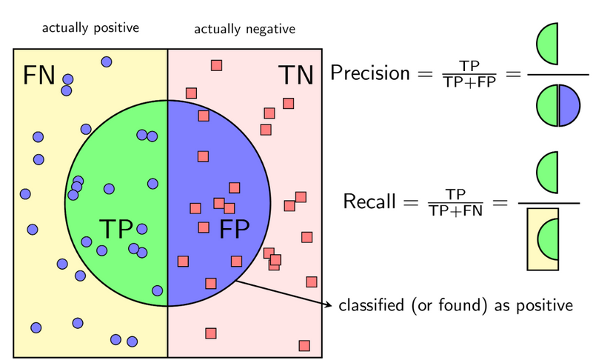
Machine Learning
Interpreting Confusion Matrix
The left diagonal shows the number of correct predictions made for each class while the right diagonal shows the number of wrong prredictions made. Lets consider the first plot for Logistic Regression:
1)The no.1 of correct predictions are 474(for dead) + 236(for survived) with the mean CV accuracy being (474+236)/891 = 79.6% which I did get earlier.
2)Errors--> Wrongly Classified 75 dead people as survived and 106 survived as dead. Thus it has made more mistakes by predicting dead as survived.
By looking at all the matrices, I can say that Logistic Regression has a higher chance in correctly predicting dead passengers but Random Forest has a higher chance in correctly predicting passengers who survived.

Slide 28
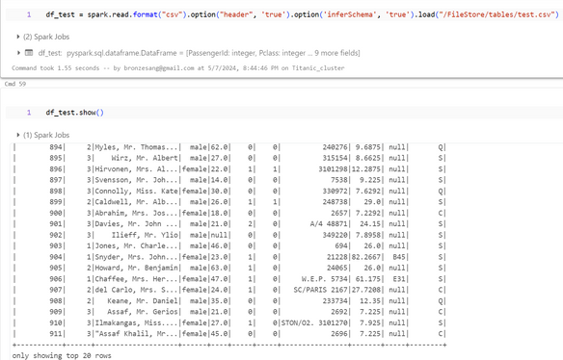
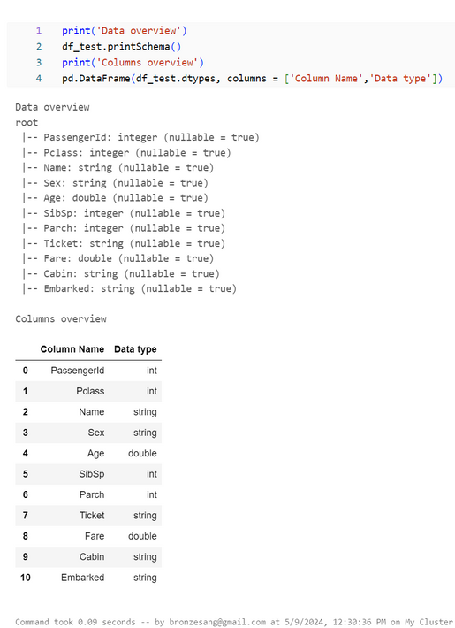
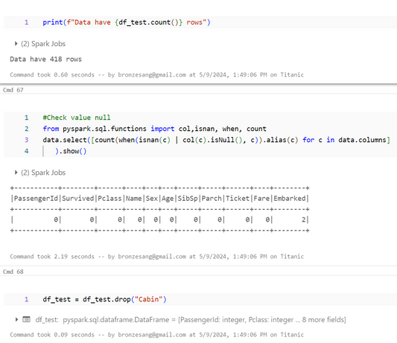
Machine Learning
3.3 Make prediction on Test data
Test.csv have 419 element, but It not have column Survived
EDA test.csv: check null, drop column “Cabin”

Slide 29
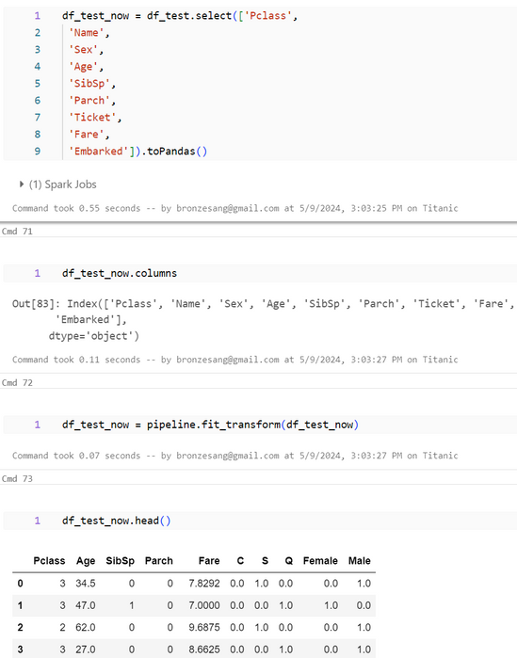
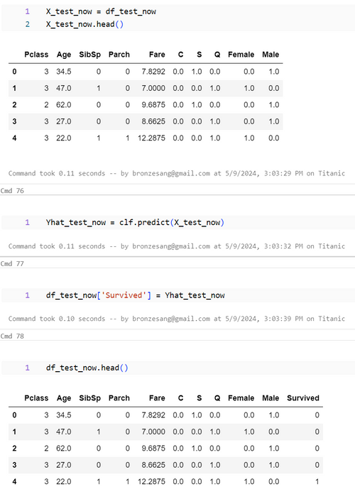
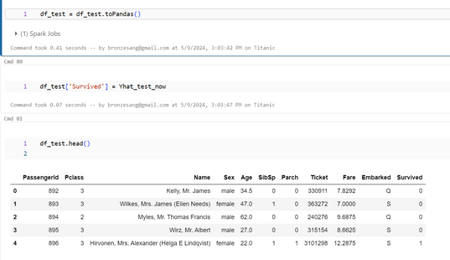
Transform data, make column predict Survived

Slide 30
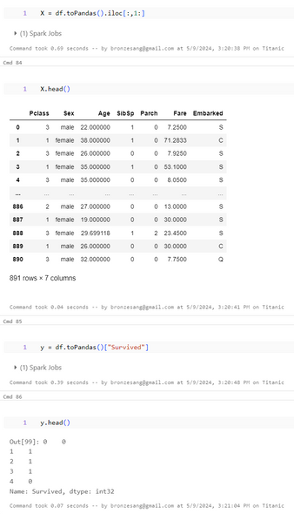


Machine Learning
3.4 Pipeline
pipeline train data, and make new column Survivied in test_data.
We will compare

Slide 31



Save new csv = test_pred.csv
We can see column Survived and Survived New just other 8 elements
So the model can be accepted because the error is not much

